Slide 1
FALL 2024 Sophomore year REGISTRATION

Slide 2
Bring your laptop!
Registration timeline
In Classes
Thursday, Feb. 8 - in your English class
Throughout the Spring/Summer:
You will have opportunities to make changes.
As soon as a rough draft of the schedule is built, you can see your schedule in PowerSchool.

Slide 3
The importance of planning
Choosing your classes is a very important process.
Seek out resources to help you make the decision:
Current teachers who know you and can give suggestions on your next level class
Your counselor
Teachers of the classes you are considering
Parents
College admission web sites
Friends/siblings who have taken the class
LC Course Catalog (www.lctigers.com – under Learn)

Slide 4
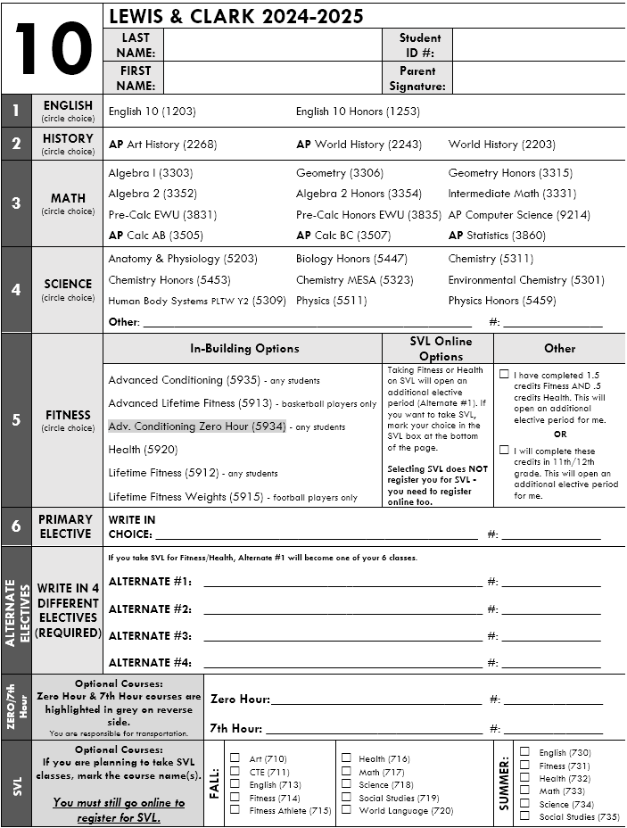
COMPLETING your registration FORM
Be sure you are using the form for your NEXT grade level. If you lose it, we have more in the office.
Select options for your core classes - boxes 1-5.
Write in your top Primary Elective choice - box 6.
Provide the 4 alternate options. These choices will be required when you register in PowerSchool.
Complete the Optional sections if you want Zero, 7th Hour, SVL or Running Start.

Slide 5
FALL 2024 CLASSES

Slide 6
English options
English 10
Honors English 10

Slide 7
Social studies options
AP Art History
AP World History
World History

Slide 8
Math options
AP Statistics
AP Calculus AB/BC
Pre-Calculus
Regular or Honors (EWU)
AP Computer
Science
Algebra 2
Regular or Honors
Geometry
Regular or Honors
Intermediate
Math
Algebra 1

Slide 9
Science options
Biology Honors
Chemistry
MESA Chemistry
Honors Chemistry
Physics 1
Honors Physics
Anatomy & Physiology
Environmental Chemistry
Principles of Biomed Sci PLTW Year 1
Human Body Systems PLTW Year 2
AP Biology
AP Chemistry
AP Computer Science
AP Environmental Science
AP Physics 1 Algebra-Based
AP Physics C Calculus-Based

Slide 10
Fitness/health options
Health
Lifetime Fitness (any students)
Advanced Conditioning
(any students)
Advanced Lifetime Fitness (basketball players only)
Lifetime Fitness Weights (football players only)
O Hour
Advanced Conditioning
SVL
Fitness or Health
SVL Athlete Option Fitness
For students who are in a school or club sport.

Slide 11
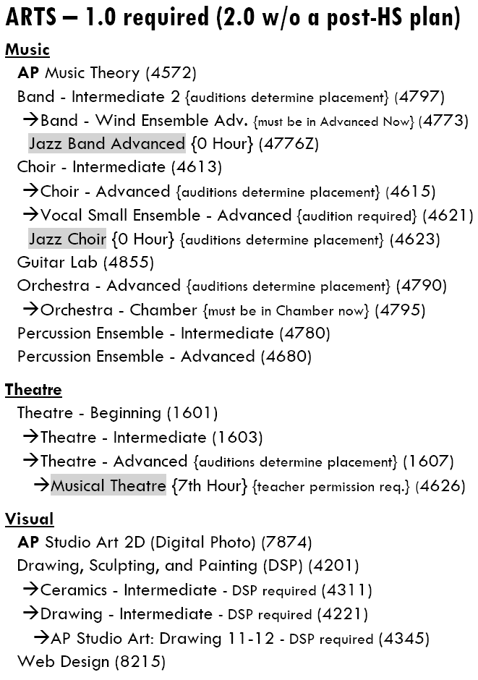
ELECTIVES
Electives are listed on the back of your form.
Some courses have pre-requisite courses you must complete before moving on to the advanced class.
These courses are indicated with an indentation and an arrow (→).
When choosing electives, be sure you write the course name and number that exactly matches your selection.

Slide 12
CTE Applied Technology
Intro to Engineering Design
Computer Science Essentials
TV/Video Production
Civil Engineering & Arch.
Web Design
AP Studio Art:
Digital Photography
Principles of Engineering
Digital Game Programming
Yearbook
(permission required)
Cyber Security
Principles of Biomed Yr 1
AP Principles of
Computer Science
Human Body Systems Yr 2
Medical Interventions Yr 3
AP Computer Science
Biomed Innovations Yr 4
Sports Medicine

Slide 13
Cte business
Accounting
Criminal Justice
Business & Marketing
Legal Studies
Adv. Business & Marketing (DECA)
Leadership in Business/ASB
Store Operations Mgmt. (Tiger Den)
Personal Finance (Business Co-Op)
Independent Business Project
Sports & Entertainment Marketing
Business Education Work Site Exp.
7th Hour (credit for your job)
You must have already taken a CTE course

Slide 14
Cte family & consumer science
Child Development
Foods & Nutrition/
International Foods
Careers in Education/
Teaching Academy
Culinary Arts/ProStart
Year 1
Careers in Education/
Teaching Academy Year 2
Culinary Arts/ProStart
Year 2

Slide 15
HUMANITIES
AP Human Geography
AP Psychology
Debate (O Hour)
Journalism - LCTV (O Hour)
Psychology

Slide 16
MUSIC
Band
orchestra
choir
Intermediate 2
Advanced
Intermediate
Advanced Wind Ensemble
Chamber
Advanced
Percussion
Vocal Small Ensemble
Jazz Band (O Hour)
Jazz Choir (O Hour)
Guitar Lab
AP Music Theory

Slide 17
THEATRE
VISUAL ARTS
Beginning Theatre
Drawing, Sculpting, & Painting
Intermediate Theatre
Ceramics
Drawing
Advanced Theatre
Musical Theatre
7th Hour
AP Studio Art: 2D Design
AP Studio Art: Digital Photography
Stagecraft
(O Hour)
Web Design

Slide 18
WORLD LANGUAGES
Most 4-year universities require 2 consecutive years of the same language, some colleges require 3 years.
Check the college admission requirements for the school(s) you are considering.
Chinese French Japanese Spanish
Chinese
French
Japanese
Spanish
Year 1
Year 1
Year 1
Year 1
Year 2
Year 2
Year 2
Year 2
Year 3 Honors
Year 3 Honors
Year 3 Honors
Year 3 Honors
Year 4 Honors
AP Year 4
Year 4 Honors
Year 4 Honors
Year 5
AP Year 5

Slide 19
SPECIAL ELECTIVE PROGRAMS
ICAN Credit Recovery
(6th, 7th Hour)
GENERAL
ELECTIVE
Late Arrival Periods 1-2-3
Early Dismissal Periods 4-5-6
(you must still have 6 credit-bearing classes which can be during the school day, on SVL, Zero Hour,
7th Hour)
NO
CREDIT
ISSUED

Slide 20
Confirm you can log into PowerSchool on a computer - the phone app doesn’t have the registration feature.
If you don’t remember your login/password, go to the Public or Student Office and ask for a reset this week.
Don’t wait until registration day to get a reset!
Next steps
Start to pencil in your schedule on your registration form (if you need a new one, come to the Student Office).
Use your resources to design the best schedule for your goals, interests, and graduation requirements.
Teachers and parents - ask their advice!
www.lctigers.com - go to Learn at the top, select Course Registration

